Slide 1



Welcome To Presentation
LIBRARY MANAGEMENT

Slide 2


TEAM MEMBERS
∆Mohammed arkhum khan - 20241CSN0008
∆Sourav Shekhawat - 20241CSN0011
∆Manya D Yadav - 20241CSN0012
∆Advika Anand - 20241CSN0009

Slide 3




Library management
Manage Inventory
Dashboard
Manage User Records

Slide 4

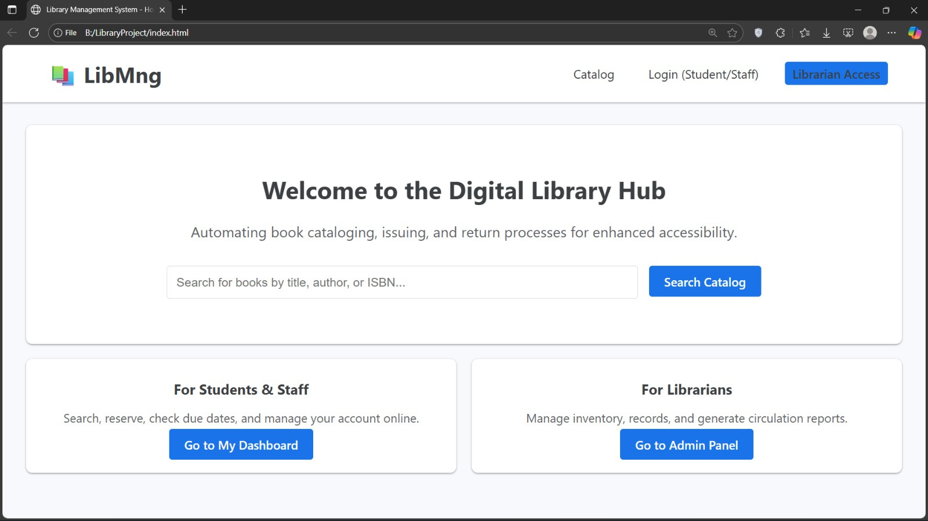
HOME PAGE

Slide 5

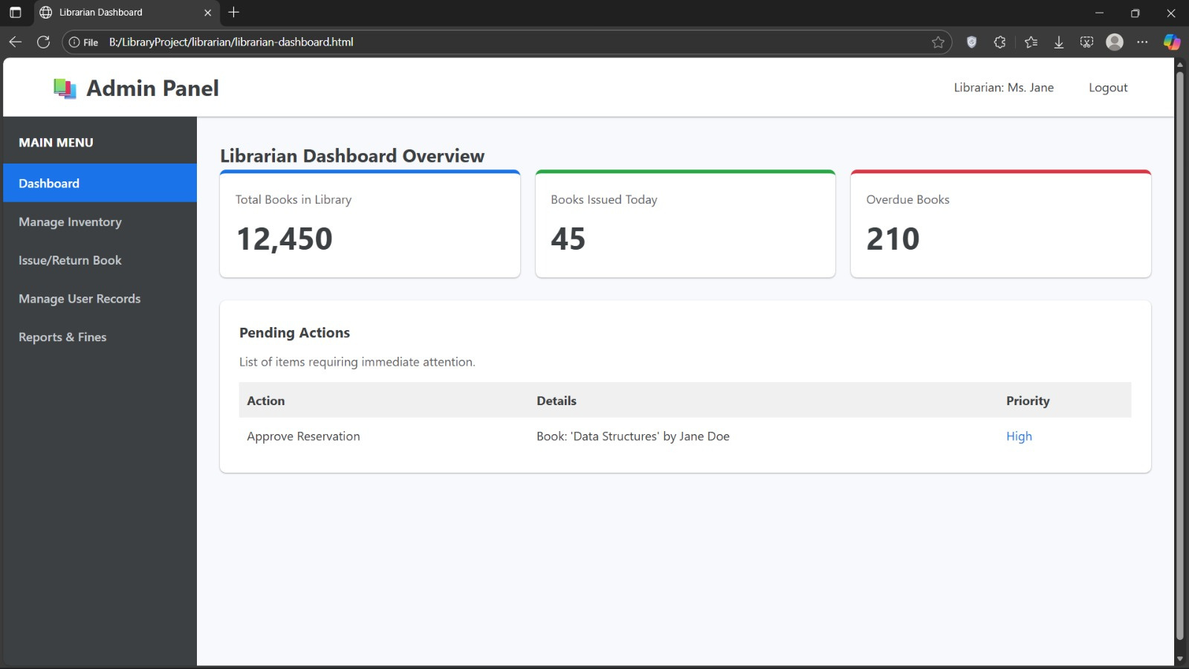
Library Dashboard

Slide 6
Dashboard Overview
Key features
1.Manage User Records
2.Pending Actions
3.Inventory & Circulation Management
4.User & Financial Administration

Slide 7
The Dashboard Cards Layout

Slide 8

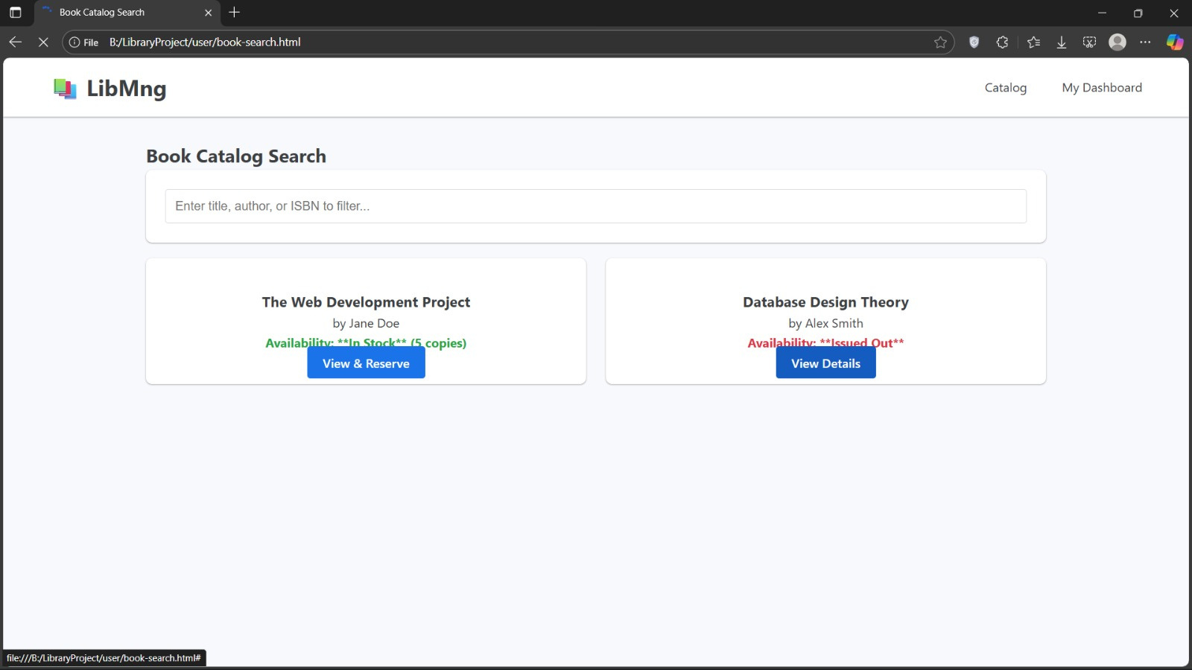

Inventory & Circulation Management

Slide 9
Inventory & Circulation Management
∆Search Functionality
∆Clear Catalog Navigation
∆Book Information Cards
∆Real-Time Availability Status
∆Action-Oriented Buttons

Slide 10
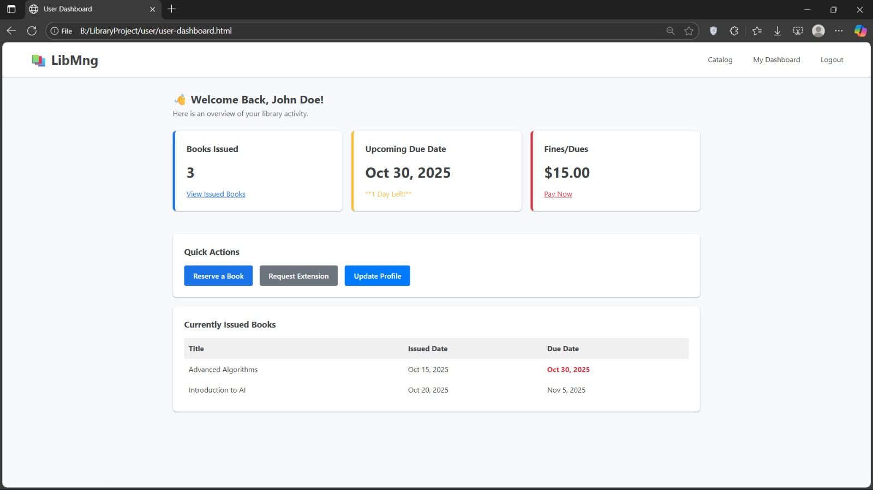
User & Financial Administration

Slide 11
User & Financial Administration
∆Personalized Activity Summary
∆Self-Service Quick Actions
∆FINES/DUES

Slide 12
Gallery Image

Slide 13

Thank you!

